Slide 1
Microcontrollers mini project
Dhriti- A Woman Safety Device

Slide 2
Introduction
Due to a rise in the crime rate, women feel unsafe stepping out of their homes. With the help of technology, devices are now being built to improve the safety of women.
We propose a device - Dhriti, that will generate an emergency alarm and also send messages and emails asking for help to concerned people. Women carrying this device can send an alert message to a specified contact by pressing the SOS button.
In this project, NodeMCU will be interfaced with a GPS module and IFTTT (IF This, Then That) for getting location coordinates and sending alert SMS/Email.

Slide 3
Problem statement
To alert and send the geo-location information of women who are in trouble to predefined contacts through messages/emails asking for help.

Slide 4

PROPOSED SYSTEM
The main two components used in this device are NEO 6M GPS module and NodeMCU ESP8266
GPS module receives data from the satellite once Position Fix has been found
Node MCU is a WIFI module that can be used to connect to the internet using the WiFi network provided in the program code
Once the SOS button is pressed, the GPS coordinates received by the GPS module is sent to a concerned person’s SMS/Email using IFTTT server

Slide 5
When the SOS button is pressed, AN ALERT MESSAGE CONTAINING THE USER’S EXACT LOCATION IS SENT TO A CONCERNED CONTACT
I need help! My Coordinates are: {Longitude}, {Latitude}.
View
Message

Slide 6
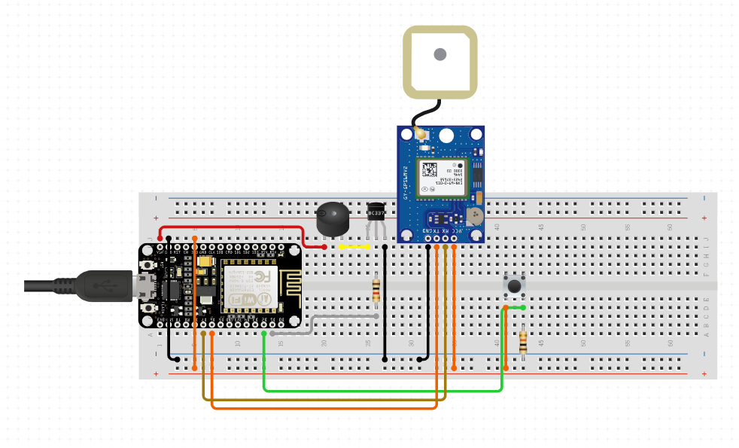
Hardware and software specifications
CIRCUIT DIAGRAM

Slide 7
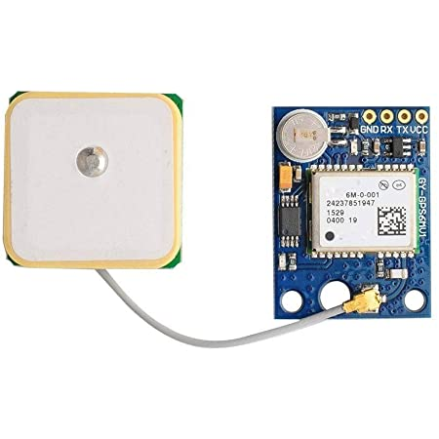
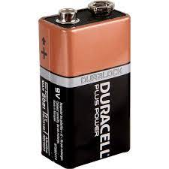
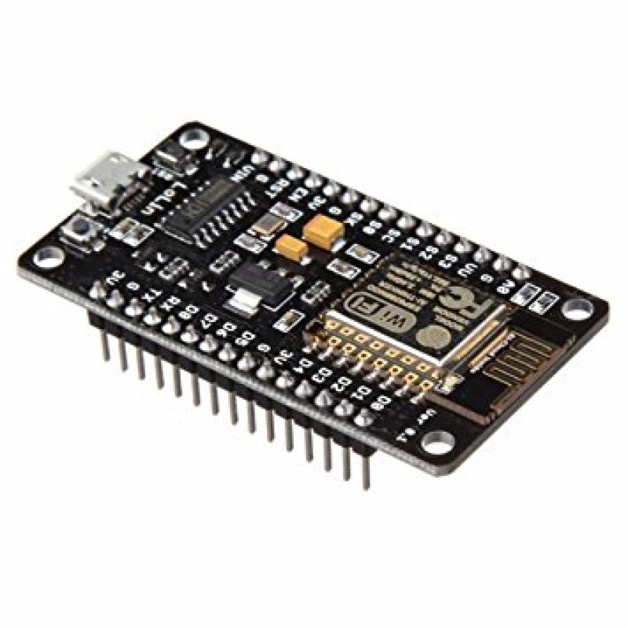
Neo-6m gps module
Nodemcu esp8266
Power source
The NEO-6M GPS module is one of the popular GPS receiver modules with a detachable ceramic antenna, which can provide strong satellite search capability.
The ESP8266 is a self-contained WiFi networking solution offering as a bridge from existing microcontroller to WiFi and is also capable of running applications.
The primary function of a power supply is to convert electric current from a source to the correct voltage, current and frequency to power the load.

Slide 8
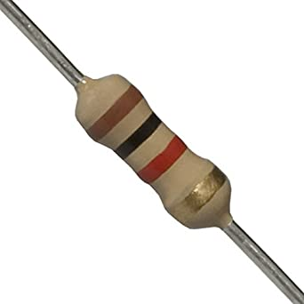
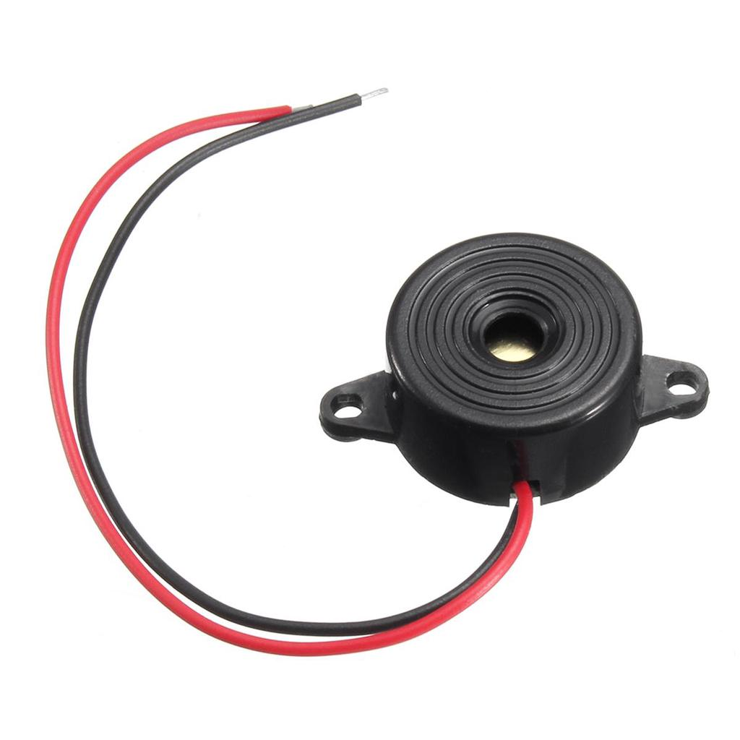
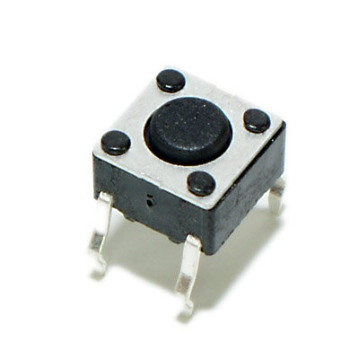
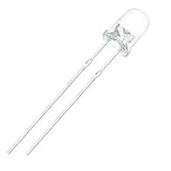
resistor
Push button
led
Buzzer
Resistors are the electronic components who have a specific, constant electrical resistance.
Buzzer is a kind of voice device that converts audio model into sound signal. It is used mainly to prompt or alarm.
A push button is a component which can be used as a switch to control an action in a machine or some type of process.
A Light-emitting diode (LED) is a light source which is a semiconductor that emits light when current flows through it.

Slide 9

VIDEO DEMO

Slide 10
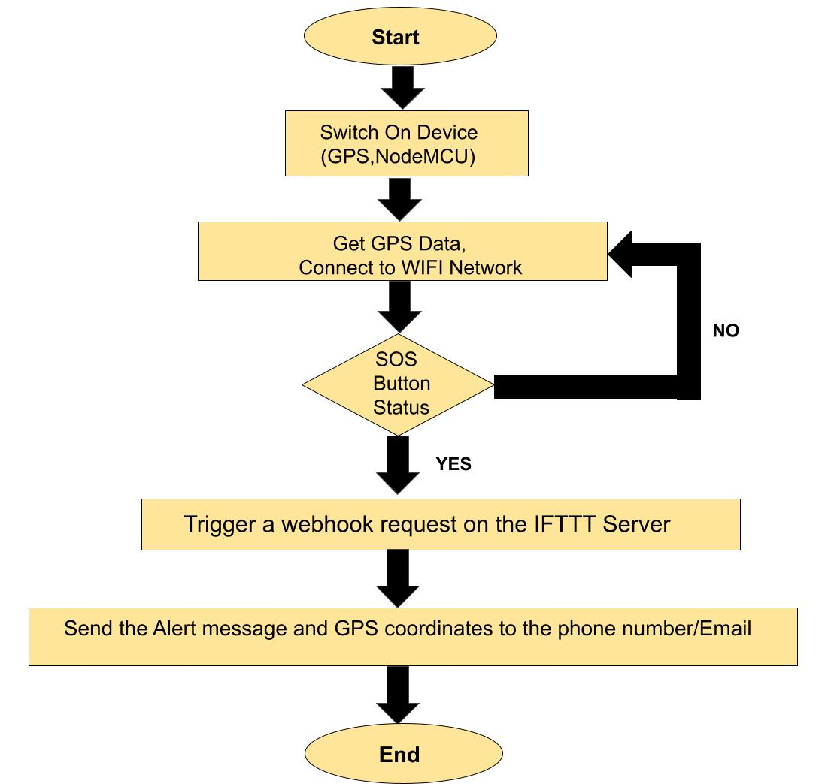
flowchart

Slide 11
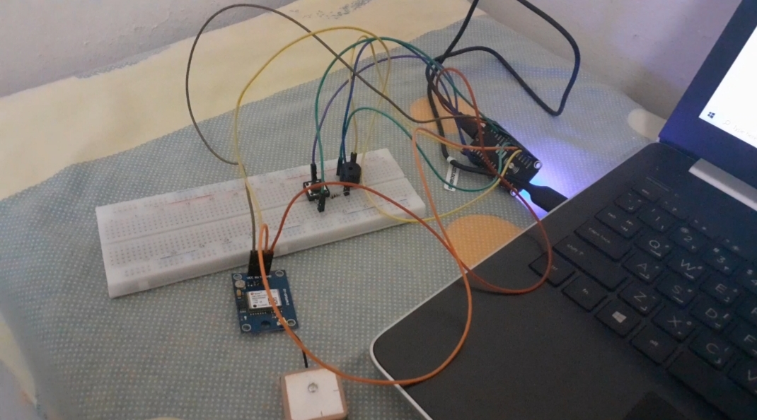
WORKING
• When the device is turned on using a power source, NodeMCU will get connected to the given WIFI Network and the GPS module starts receiving data in the NMEA format once a Position Fix has been found.
• NodeMCU will decode the NMEA data into GPS Coordinates using certain libraries and display it on serial monitor.
• As soon as the SOS button is pressed, the built-in LED of NodeMCU is turned on to indicate that the system has been activated. NodeMCU will then start connecting to the IFTTT server and make a Webhook request, along with the GPS Coordinates.
• As soon as the Webhook request is triggered from NodeMCU, the Email applet gets activated and an alert message is sent to the Email id configured by the user, containing the location coordinates of the user.
HARDWARE SETUP

Slide 12
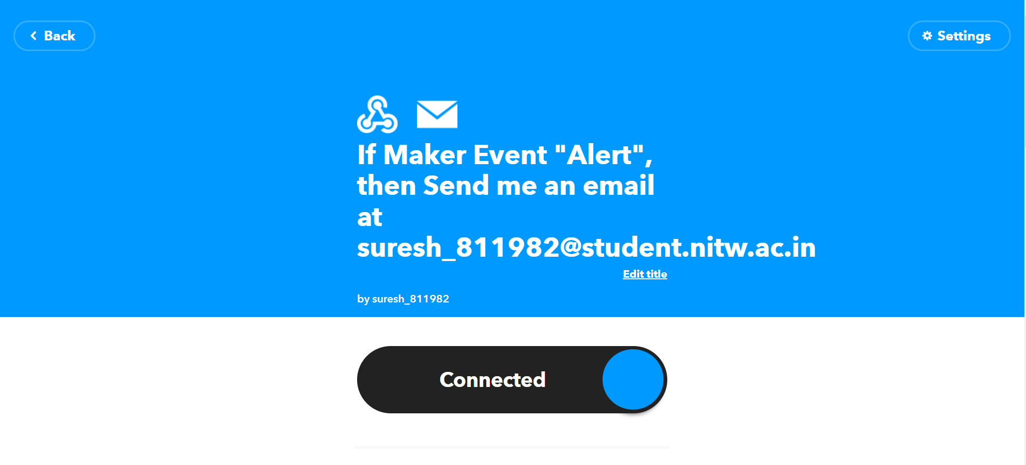
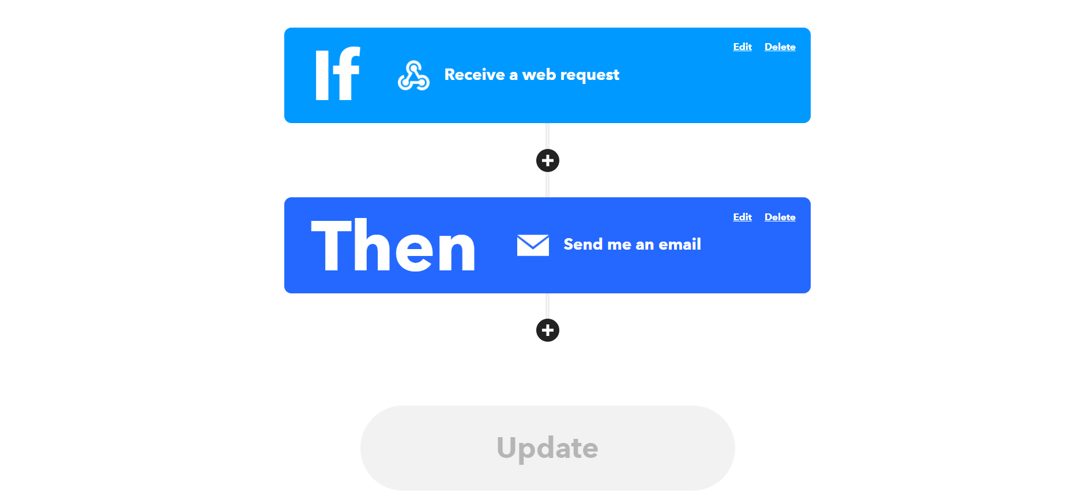

Slide 13
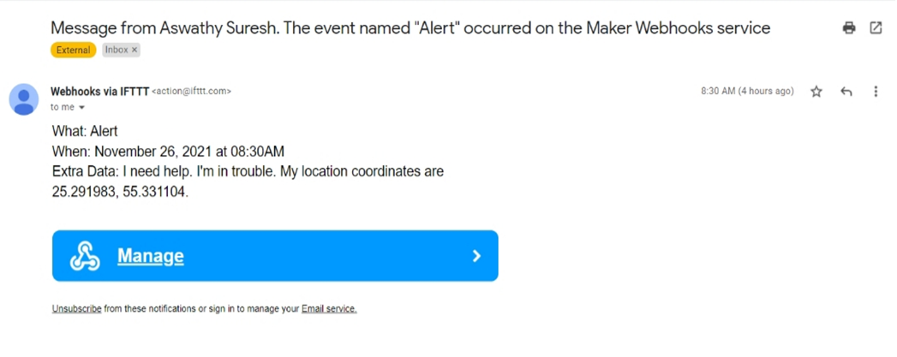
RESULT

Slide 14
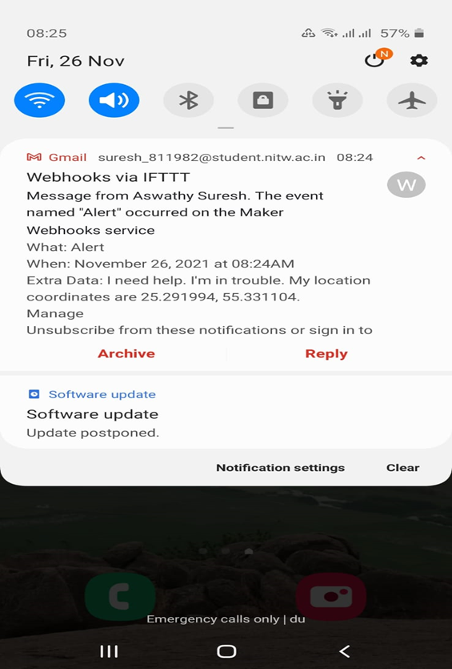
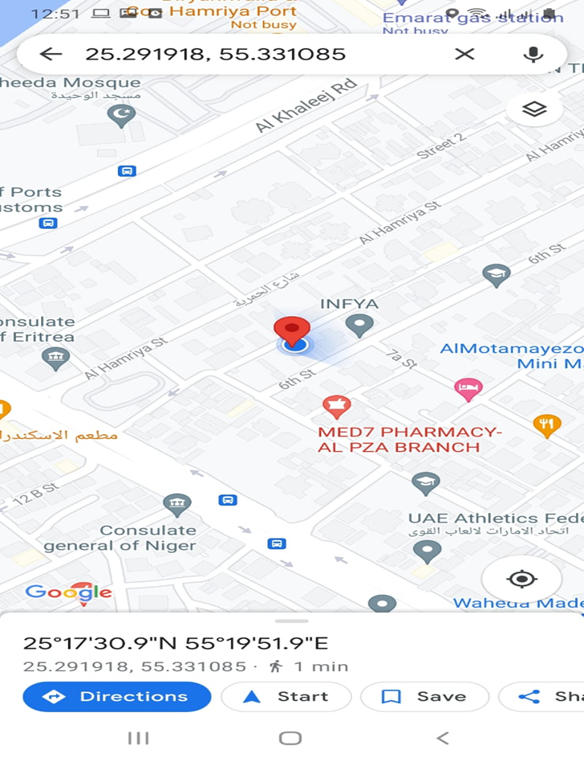

Slide 15
Advantages
01
LEGAL evidence
02
affordable
03
portable
04
Easy to use
Can be used as legal evidence of crime with exact location information prosecution.
It is affordable, not expensive.
It is portable and WiFi-Enabled.
It is comfortable and easy to use by just clicking the SOS button.

Slide 16
OTHER APPLICATIONS
Vehicle tracking
Safety of Physically challenged people
safety of children
Security applications.
Safety of elderly aged people
Future Scope
For the better functionality of the product new versions of the device can be introduced by adapting new technologies.
Functionalities like voice detection, camera can be added and some kind of tools for defense like shock generator can be implemented.

Slide 17
team
Aswathy Suresh - 194211
Kotakonda Abitha Rao - 194238
Vineela Kunkatla - 194186

Slide 18
REferenceS
https://create.arduino.cc/projecthub/Arnov_Sharma_makes/u-blox-neo-6m-gps-module-tutorial-0753d9
https://create.arduino.cc/projecthub/Niv_the_anonymous/esp8266-beginner-tutorial-project-6414c8
https://lifehacker.com/the-beginners-guide-to-ifttt-1819624556
https://randomnerdtutorials.com/guide-to-neo-6m-gps-module-with-arduino/

